Slide 1
UNIT 1: INTERPRETATION
1: The Value of Data + Data Narratives
2: Excel Fundamentals
3: Data Referencing
4: Data Aggregation
5: Data Visualization
6: Statistics in Excel*
James Larkin – Data Analytics Instructor
Notes:
* Indicates a FLEX lesson

Slide 2
THE VALUE OF DATA +
DATA NARRATIVES

Slide 3
DATA NARRATIVES
OPENING

Slide 4
LEARNING OBJECTIVES
DATA NARRATIVES
In today’s lesson, we will:
Explain our Data Analysis course objectives and tools.
Explore the Data Framework and iterative problem-solving.
Discuss the value and impact of data-driven decision making.
Introduce Project 1
Discuss a brief history of visual analytics.
Survey common presentation strategies.
Practice applying techniques to a sample business case.
Defined some methods for selecting appropriate visuals.

Slide 5
THE VALUE OF DATA
INTRODUCTION: DIVE INTO DATA
Notes:
Instructor Note: This section is intended as a brief way to immediately engage students in some examples in order to contextualize the information covered in this lesson. In these examples, ask students to focus on what data is being shown, how that data is conveyed, and what takeaways or action items does that data imply? The goal is to demonstrate a few of the different ways that we interact with, experience, and leverage data on a daily basis.

Slide 6
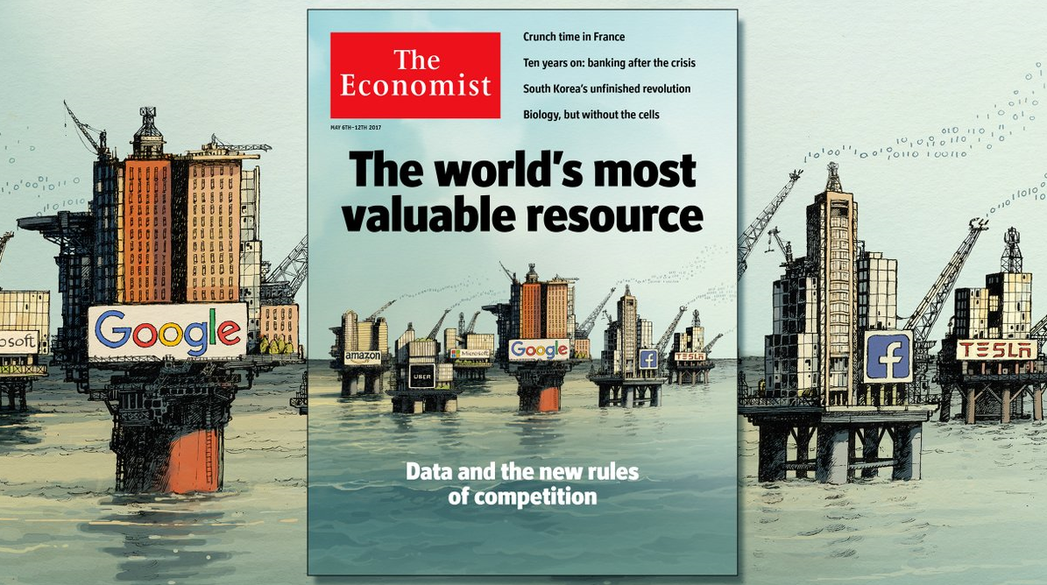
THE VALUE OF DATA
Source: (May 2017) https://goo.gl/Np5lJ6
Notes:
Instructor Talking Point: Why are we here? Because data is the world’s most valuable resource. Which means *you* will be the most valuable players.

Slide 7


AI vs. HI - WHERE THE DECISION GETS MADE
HI
AI
mining
training
Notes:
Where the decision gets made
Simple systems can have automated decision making processes (manufacturing processes, etc)
Complex systems can pre-process data which is later interpreted by a human for decision making
The trend through time is to continually refine this process and move the slider rightward

Slide 8
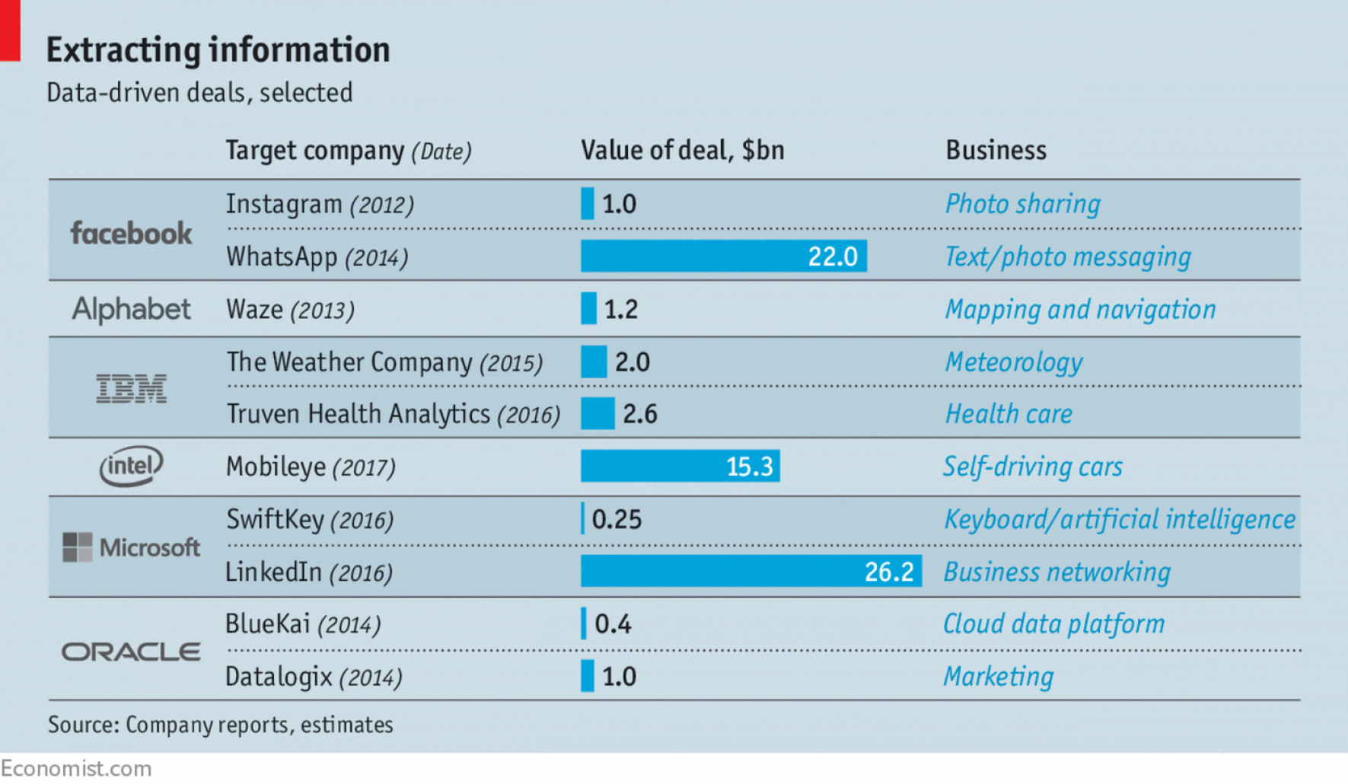

THE VALUE OF DATA: DEAL-MAKING
Source: Economist (May 2017) https://goo.gl/agTRgb
Notes:
Instructor Talking Point: As The Economist shows, data-driven deals represent the future of our information economy.
@chrisalbon -
2007: You are the product
2017: You are the training data

Slide 9
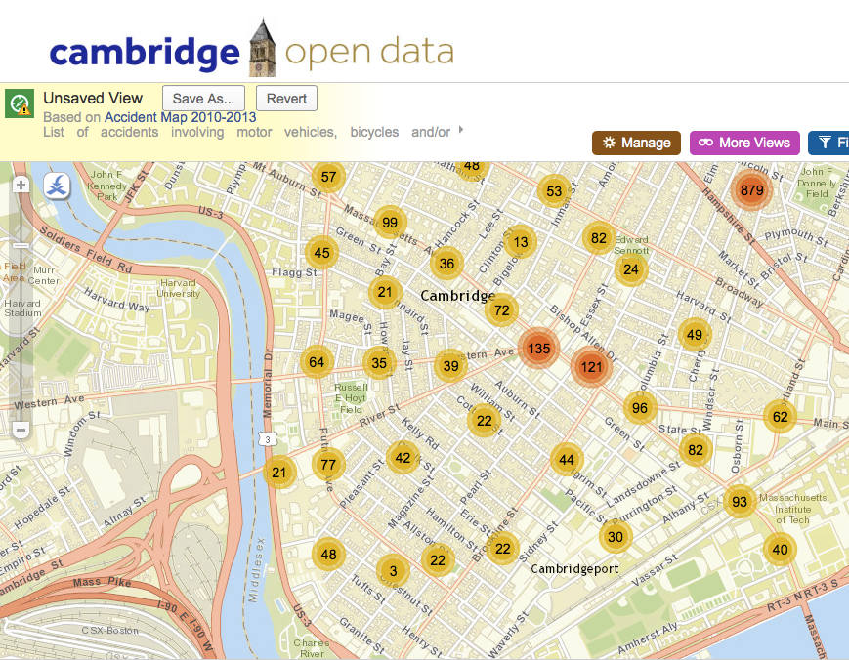
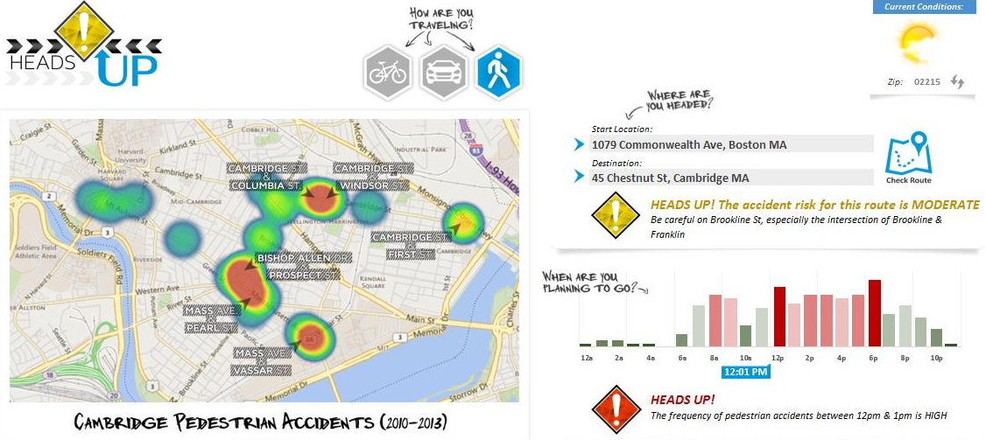
EXAMPLE: PEDESTRIAN ACCIDENT DATA
CAMBRIDGE, MA
Insights? Actions?
Question(s)?
Source: http://www.opendatanation.com/news/
Notes:
Instructor Talking Points: Let’s start out by taking a look at these sample data visualizations and dashboards. If you were traveling by foot in Cambridge and saw this information, how might it affect you? Instructor Prompt: What data is being shown? How is this data conveyed? What takeaways or action items does this data imply?

Slide 10

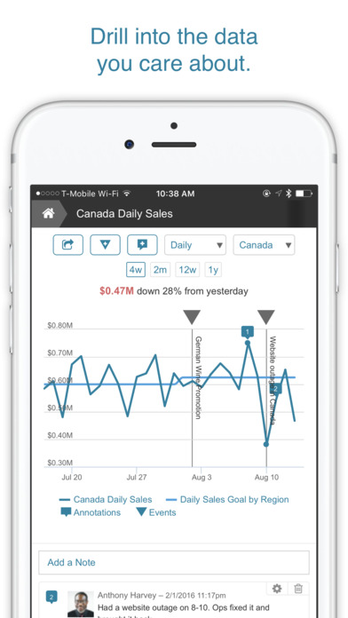
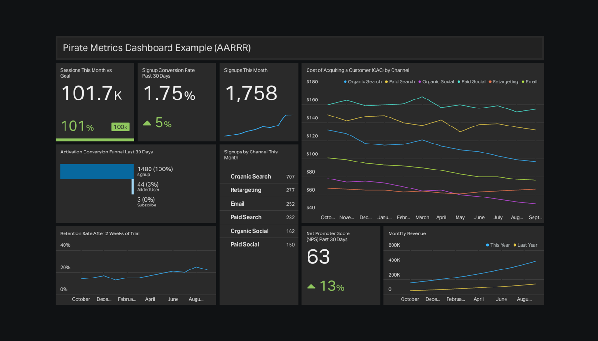
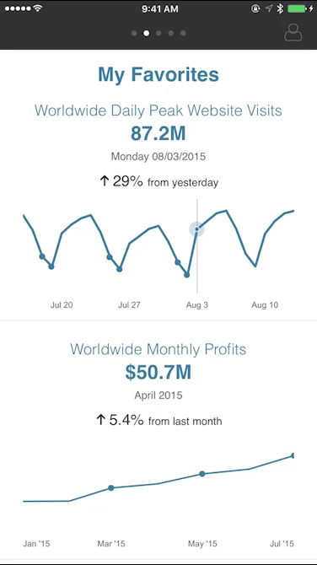
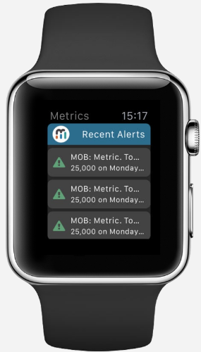
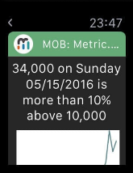
EXAMPLE: MOBILE DASHBOARDS
Notes:
Instructor Talking Point: In what ways does the design of these dashboards provide relevant data to different types of users?
Instructor Prompt: What data is being shown? How is this data conveyed? What takeaways or action items does this data imply?

Slide 11
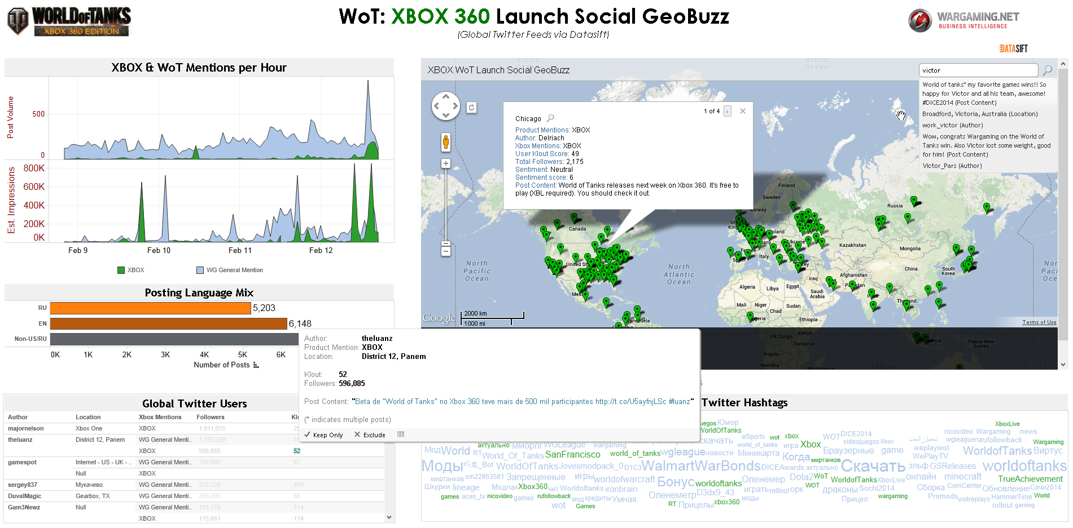
EXAMPLE: SOCIAL MEDIA BUZZ
Source: WG.net “ROI of BI” presentation (2015)
Notes:
Instructor Talking Point: In this example, how might data be used to avoid over-accommodating a “vocal minority” of posters/trolls? Instructor Prompt: What data is being shown? How is this data conveyed? What takeaways or action items does this data imply?

Slide 12


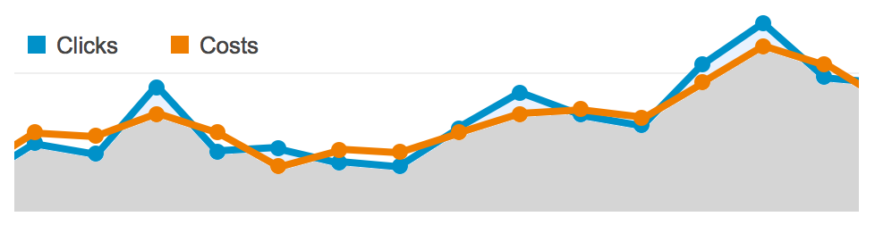

THE VALUE OF DATA: DATA-DRIVEN DECISIONS
Issue: Google AdWords spending analysis.
CEO’s question: “What is the ad spend ROI on 3,200 keywords?”
Ad agency analysis: 98% of the revenue is coming from only 22 words.
22 words = “Restoration Hardware” + 21 misspelled variations.
CEO’s reply: “Cancel — no need to buy our own name from Google.”
Source: Zero Hedge (Sep 2017) https://goo.gl/9AVNMD
Notes:
Instructor Prompt: Here is an example of how a problem can be broken down into data-driven elements and used to inform impactful business decisions.
Note: Be sure to clarify that ‘Restoration Hardware’ is the name of a hardware store business. Because folks are misspelling the name and most traffic comes from the name itself, the CEO doesn’t feel the need to channel marketing budget toward other ad words.

Slide 13


THE VALUE OF DATA: DATA-DRIVEN DECISIONS
Issue: American Express needs a data model to predict customer churn.
Source: HBS (Apr 2017) https://goo.gl/62HVDt
Notes:
Instructor Prompt: Now you try: we’ll take the same approach to a sample scenario from American Express. How would you deal with this issue? (Note: Prompt and get students to suggest a few ideas before moving to next slide)

Slide 14
THE VALUE OF DATA: DATA-DRIVEN DECISIONS
Goals & Outcomes:
Preserve 100M global cards, $1T annual charges.
Biz model: Targets affluent customers ($150/charge vs. Visa $50/charge).
Developed big data churn forecast model with 115 variables.
Flagged 24% of accounts to churn next qtr → retention marketing.
Also reduced personalization model from three days to 20 minutes.
Machine learning increased online customer acquisition by 40%.
Source: HBS (Apr 2017) https://goo.gl/62HVDt
Notes:
Instructor Prompt: Here are some sample goals and data points that were actually used to solve this issue (predicting customer churn).

Slide 15


ACTIVITY: DATA-DRIVEN DECISION MAKING
DIRECTIONS
Pair up with the person next to you. Take five minutes to…
Discuss if and how your department views data as a strategic asset (either currently or at a former place you’ve worked).
Describe an example of a data-driven decision (or the opportunity for one) in a current or former business unit that you’ve been a part of. BONUS: List 1–2 current blockers to making data-driven decisions.
ACTIVITY
DELIVERABLE
Share out various examples of data-driven decisions from the class.

Slide 16
THE VALUE OF DATA
INTRODUCTION: OUR COURSE GOALS

Slide 17
COURSE: GOALS
Empower your problem-solving skills by building a data-driven mindset.
Identify the best tools and techniques for common data use cases.
Learn to critique, analyze, and discern insights from common data sources.
Account for the needs of key users and stakeholders in order to make your findings more persuasive.
Present data-driven observations and findings using data visualizations and dashboards.

Slide 18



COURSE: TOOLS
Excel Basic data and analytics “scratchpad.”
SQL Data access and query tool (pgAdmin for PostgreSQL).
Tableau Visual analysis, dashboards, and reporting.

Slide 19

COURSE: UNIT ONE
Data Interpretation, with Excel
We’ll be extending the Excel topics covered in our pre-work, focusing on “advanced” features of Excel like VLOOKUP, HLOOKUP, as well as PivotTables and aggregation functions.
We’ll also explore some foundational elements that apply throughout the course, including common visualization principles, compelling data narratives, and effective presentation strategies.
Excel Wizard

Slide 20


COURSE: UNIT TWO
Data Organization, with SQL
We’ll then move into SQL, discussing database fundamentals and learning how to write queries in order to efficiently retrieve and manipulate our data.
We’ll practice connecting to real-world, cloud-based databases, creating queries to draw real-world business conclusions.
SQL Ninja

Slide 21


COURSE: UNIT THREE
Data Visualization, with Tableau
Finally, we’ll learn how to conduct exploratory analysis in Tableau in order to gain insights from multiple data sources.
We’ll learn to leverage the data visualization and storytelling capabilities of Tableau to create compelling dashboards and presentations.
Data Rock Star

Slide 22
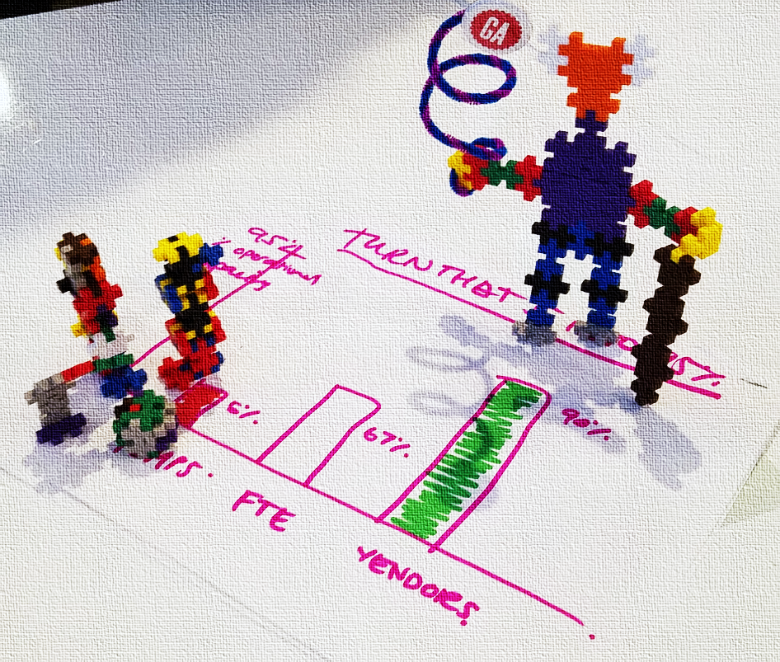
COURSE: PROJECTS
In this course, you’ll work on three projects, covering:
One project per unit, paced throughout the course.
Synthesize topics in Excel, SQL, and Tableau.
Explore and analyze real-world data sets.
Practice and apply your new skills
Build and enhance your data analysis portfolio.

Slide 23
THE VALUE OF DATA
INTRODUCTION: HOW TO THINK ABOUT DATA

Slide 24
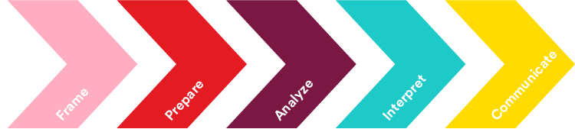
GA: DATA WORKFLOW
Develop hypothesis- driven questions for your analysis.
Select, import, & clean relevant data.
Structure, visualize & complete your analysis.
Create insights and business decisions from your analysis.
Present data-driven findings and recommendations to your audience.
Notes:
Instructor Prompt: The GA “Data Workflow” is a problem-solving framework that we’ll use throughout the course to break down issues and structure our solutions.

Slide 25
GA: DATA WORKFLOW
Frame Your Data
Define data-driven questions.
Prepare Your Data
Select, import, and clean relevant data.
Analyze Your Data
Structure, understand, and visualize your data.
Interpret Your Data
Leverage your analysis to make decisions and recommendations.
Communicate Your Data
Present your results and insights in a compelling manner.
Notes:
Instructor Prompt: The GA “Data Workflow” is a problem-solving framework that we’ll use throughout the course to break down issues and structure our solutions.

Slide 26
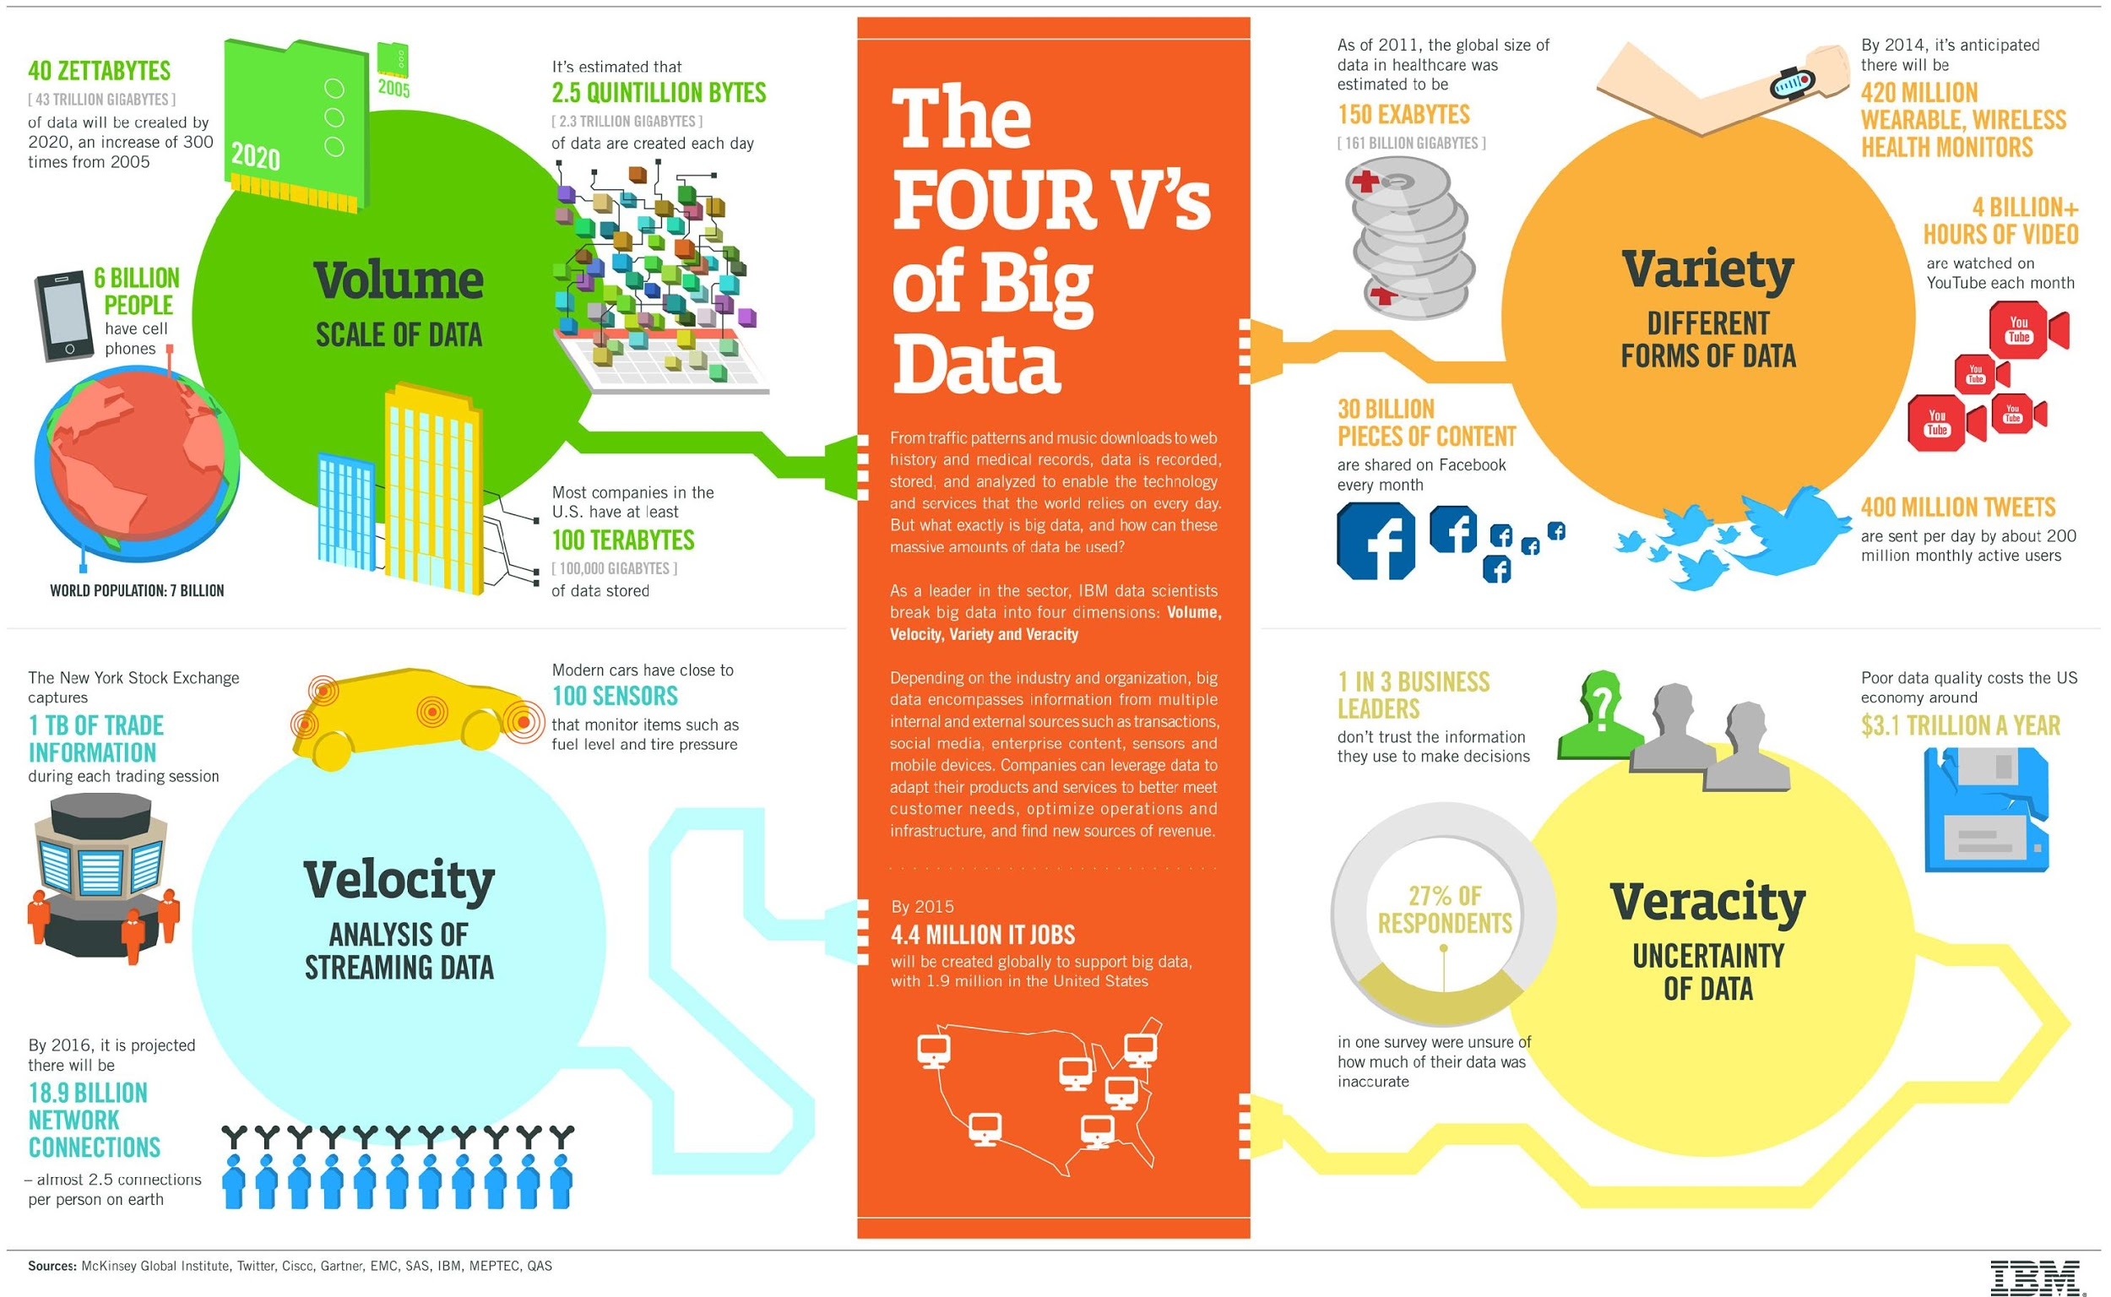
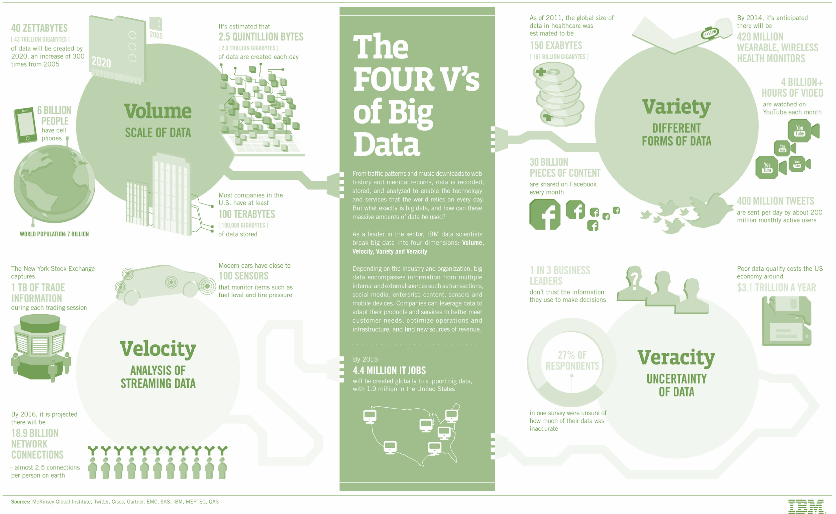

+ Value
Notes:
Instructor Prompt: What are the 4 V’s of data? These are four factors to consider when working with any data problem. You can think of them as four questions to consider when approaching a data-driven project. 1. Volume: how much data is there?
2. Velocity: how fast can we process this data?
3. Variety: what types of data are we dealing with?
4. Veracity: how valid/reliable is this data?
...and of course, 5. VALUE: what is the business or financial impact of this data?

Slide 27
THE FIVE V’s OF DATA
Volume: Consider the scale of the data (big & small, structure).
Velocity: Understand data sources(s), timing, and flow.
Variety: What forms and types are required to answer questions?
Veracity: Verify quality, accuracy, and reliability of source(s).
Value: What are the metrics or measures for desired outcomes?
Notes:
Instructor Prompt: Here are some sample measurable elements to consider for each category.

Slide 28
VISUALIZATION HISTORY
PROJECT 1: AIRBNB

Slide 29
PROJECT ONE: AIRBNB INVESTMENT
Project description:
Decide whether to invest in an Airbnb property.
Choose between 4 project prompts.
Project deliverables that will be due during class:
Five-minute presentation
Data handling summary & recommendation
Excel workbook
Notes:
Instructor Note: Open the Project 1 description file and review each section with the class.

Slide 30
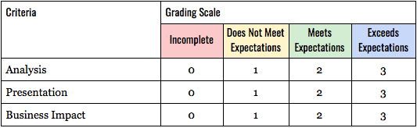
PROJECT ONE: AIRBNB INVESTMENT RUBRIC
Notes:
Instructor Note: Open the Project 1 Requirements file to demonstrate the list of requirements and evaluation methods.
Talking Points: Above is a sample rubric used to score class presentations. For more detail about how we’ll evaluate project deliverables, let’s review the Project Requirements file together.

Slide 31
DATA NARRATIVES
INTRODUCTION: PRESENTATION STRATEGIES

Slide 32


DATA AS THE STORY
Ask great questions...
...to reveal key findings.
Notes:
Instructor Talking Point: Remember, data analysis begins with asking the right questions of your data. You must first have a hypothesis in order to know what to test. This is also true in presentations!! Audiences are much more engaged when they are asked a question which the presenter proceeds to answer.

Slide 33
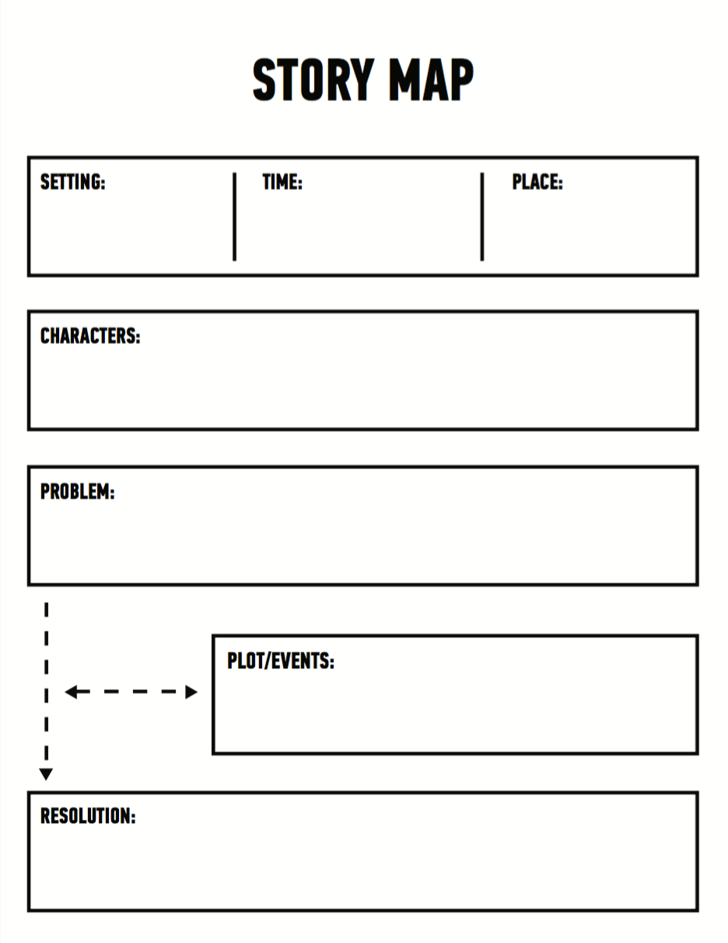
STORY MAP
A story map can be used to diagram your presentations ahead of time.
This can help you consider all of the relevant elements you may want to discuss, including:
Setting / Time / Place
People Involved
Problem
Events
Resolution
Notes:
Instructor Talking Point: A “Story map” is one tool that can be used when planning a presentation. The story map framework can be used to diagram the different types of information you need, and help you figure out how to frame that information in a productive manner.

Slide 34
STORY MAP
Setting / Time / Place
The specific business context:
Location of problem
Where was data collected?
What locations are involved?

Slide 35
STORY MAP
Characters
People and data involved:
Data dictionary?
Business unit owner?
Metadata description?
Issues of data governance?
Audience stakeholder(s) involved:
Who is the presentation for?
Identify all key decision makers.

Slide 36
STORY MAP
Problem The issues and opportunities at-hand:
Motivations?
Pain points?
Opportunities?
Hypothesis?

Slide 37
STORY MAP
Plot/Events Process, considerations, actions taken:
What did you do to solve these problems?
What was the timeline of your approach?
Explain your process in terms your audience can easily understand

Slide 38
STORY MAP
Resolution What should be done?
What are your recommendations?
Include your assumptions.
Is any additional data needed?
Communicate your results
Use visuals.
Customize this for your audience.
Make your data the focus.

Slide 39
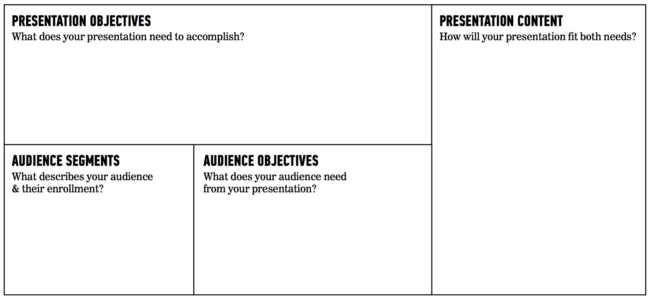
PRESENTATION CANVAS
Notes:
Instructor Talking Point: As an alternative to the story map, you can also try outlining your talk using a presentation canvas. This tool can serve as a checklist of sorts, helping you remember to ask the right questions and provide the right information for your audience’s needs. Remember: your goal should always be to convey what you think is important while also meeting the needs and expectations of your audience.

Slide 40
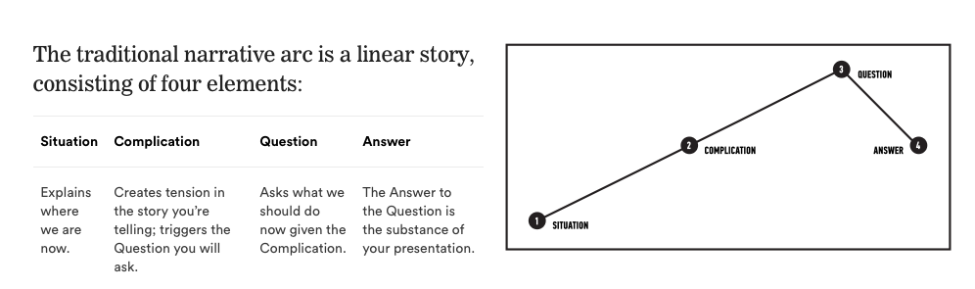
TRADITIONAL NARRATIVE: INFORMING AN AUDIENCE
“Situation:” This is the current state; define the problem(s).
“Complication:” Contextualize the problem with details.
“Question:” Given these barriers, what should be done?
“Answer:” Your call to action or methods, framed as the solution.
Notes:
Instructor Talking Point: When organizing a presentation, one question students frequently ask about is the order of information. In other words, once you know what information to provide, what next? How should you provide it? What goes first, second, etc? What are some best practices? A “story-based” approach can also help here. The following two narrative frameworks can be used to organize the information you want to present. Again, there are no hard and fast rules, but generally a linear narrative is a productive method for informing people about a call to action. This is an extremely common type of presentation in business and organizational settings.

Slide 41
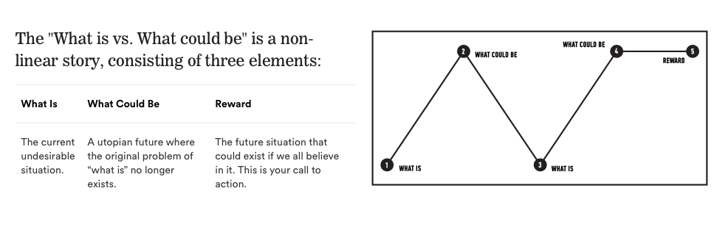
NONLINEAR NARRATIVE: PERSUADING AN AUDIENCE
“What is:” Establish the problem at-hand.
“What could be:” Communicate a vision, the desired future state.
“Reward:” New opportunities that would be unlocked by this future state.
Point: This structure frames your goals as an opportunity; connecting a specific (data-driven) future state to larger goals or initiatives.
Notes:
Instructor Talking Point: As explained in the title, a non-linear narrative order tends to be used in persuasive presentations, such as TED Talks or sales pitches.
Crafting a successful non-linear narrative requires a bit more creativity and time, but this sequence of information can be extremely compelling, depending on your goals.

Slide 42
PRESENTATION CANVAS
Develop hypothesis- driven questions for your analysis.
Select, import, & clean relevant data.
Structure, visualize & complete your analysis.
Create insights and business decisions from your analysis.
Present data-driven findings and recommendations to your audience.
Notes:
Instructor Talking Point: In some cases, a narrative based presentation sequence might still be too complicated for your needs, or not relevant enough for an extremely detailed data-driven talk to technical stakeholders. In these types of situations, our GA Data Workflow can come in handy as a multi-use heuristic. Not only does it outline the process you should use to solve problems, it also suggests a simple sequence of information you can follow in your presentation!
Follow these five steps in order to solve a problem with data.
Make sure to communicate these steps in a presentation, so that the audience understands your process and trusts your results.
When giving talks to technical stakeholders, try using this same model to organize the information you present: problem, data, process, results, recommendations.

Slide 43
PRESENTATION STRATEGIES
Point: Presentations = stories. Stories are a cultural framework that most audiences are already familiar with: setting, characters, problem, solution.
Planning presentations in this manner can help you remember to describe and focus on the people, problems, and goals involved.
Different story formats (linear vs non-linear) should be experimented with, depending on the results you want to achieve.
Finally, the GA data workflow is not just a framework for solving problems, but can also be used to help you clearly organize your data presentations.
Notes:
Talking Point: To summarize, you can use a story map approach to help define all of the inputs and components of your presentation. You can use the presentation canvas to generate useful questions and ensure you are customizing your presentation to meet both your and your audience’s needs. You can use linear or non-linear narrative frameworks to structure the information you present, depending on your goals. You can also default to a simple presentation order by using the steps from our GA data workflow.

Slide 44
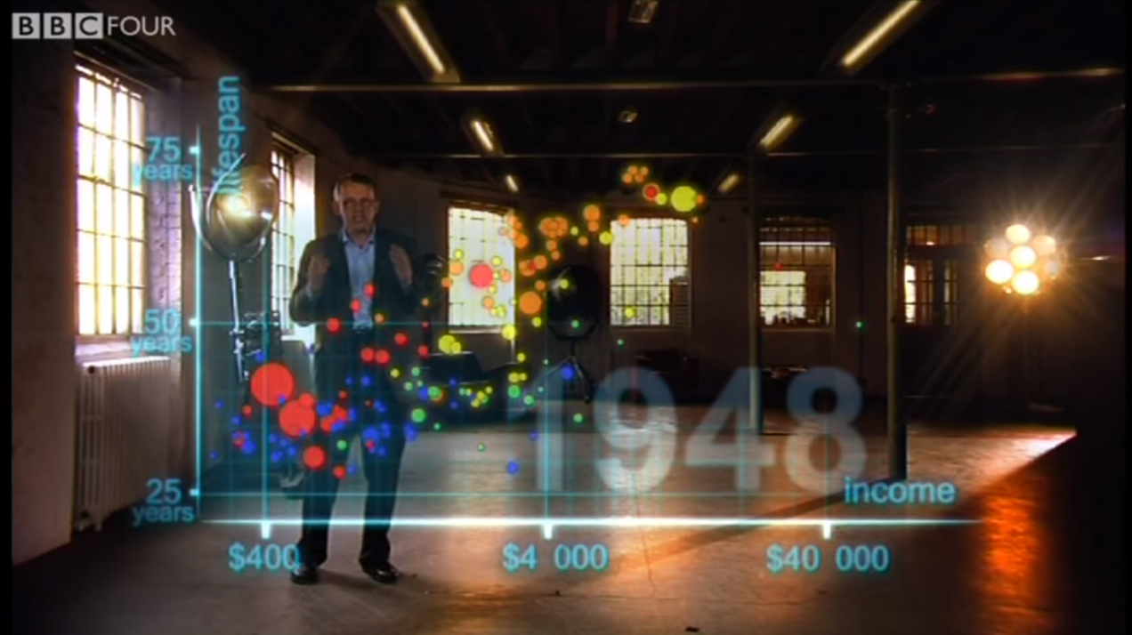
Gapminder: Hans Rosling‘s 200 Countries, 200 Years, 4 Minutes — The Joy Of Stats
DATA NARRATIVES: TELLING THE STORY WITH DATA
SOURCE: BBC 4 (YouTube video: jbkSRLYSojo)
Notes:
OPTIONAL - DISCUSSION ACTIVITY: Hans Rosling is an internationally acclaimed data analyst and TED speaker who frequently presents engaging, data-driven stories to non-technical audiences.
Watch the following short (4 minute) video and take note of the structure of Hans Rosling’s presentation.
How would you describe the story he presents?
In what order did he present his information?
What did you like or dislike about his methods?

Slide 45
DATA NARRATIVES
INDEPENDENT PRACTICE:
BUSINESS CASE

Slide 46
ACTIVITY: BUSINESS CASE QUESTIONS
DIRECTIONS
EXERCISE
In small groups, review the “Data Narrative Business Case” file.
Identify the key questions.
Prepare your findings for class discussion.
DELIVERABLE
Identify the costs, benefits, and risks of the scenario.
Notes:
Instructor Note: Tell students to work on the “Data Narrative Business Case Exercise (PDF)” A “Data Narrative Business Case Exercise solutions” file is provided for your reference.

Slide 47
DATA NARRATIVES
CONCLUSION

Slide 48
CONCLUSION
Let’s recap! In today’s lesson, we:
Discussed the upcoming components of Project 1.
Contextualized modern approaches to visual data analysis with some historical examples.
Surveyed some common strategies for creating persuasive presentations.
Reviewed some strategies for selecting the right data visualization methods in order to achieve your goals.

Slide 49
DATA NARRATIVES
Q&A

Slide 50
DATA NARRATIVES
EXIT TICKET
DON’T FORGET TO FILL OUT YOUR EXIT TICKET!

